Slide 1



Web and Internet
Class VI
lab 11

Slide 2

Popular Webmail Provider
Gmail
Outlook.com (Hotmail)
Yahoo! Mail

Slide 3
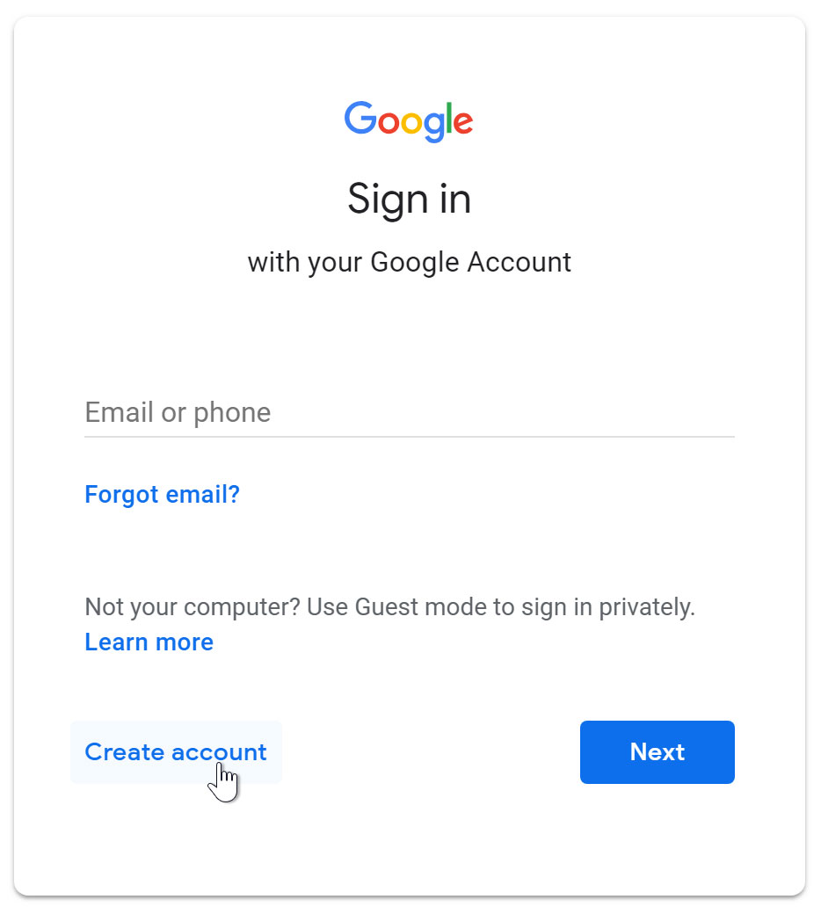
Create an Email
go to
www.gmail.com
click on
Create account

Slide 4
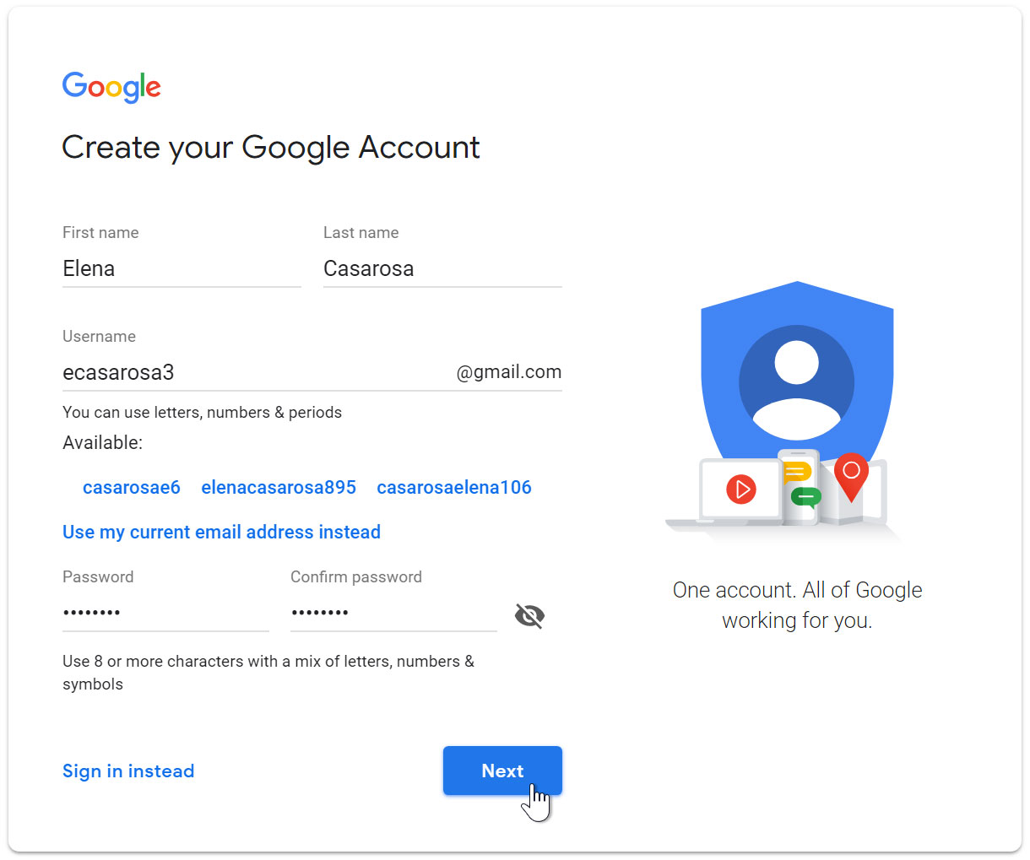
Create an Email
fill the user information form

Slide 5
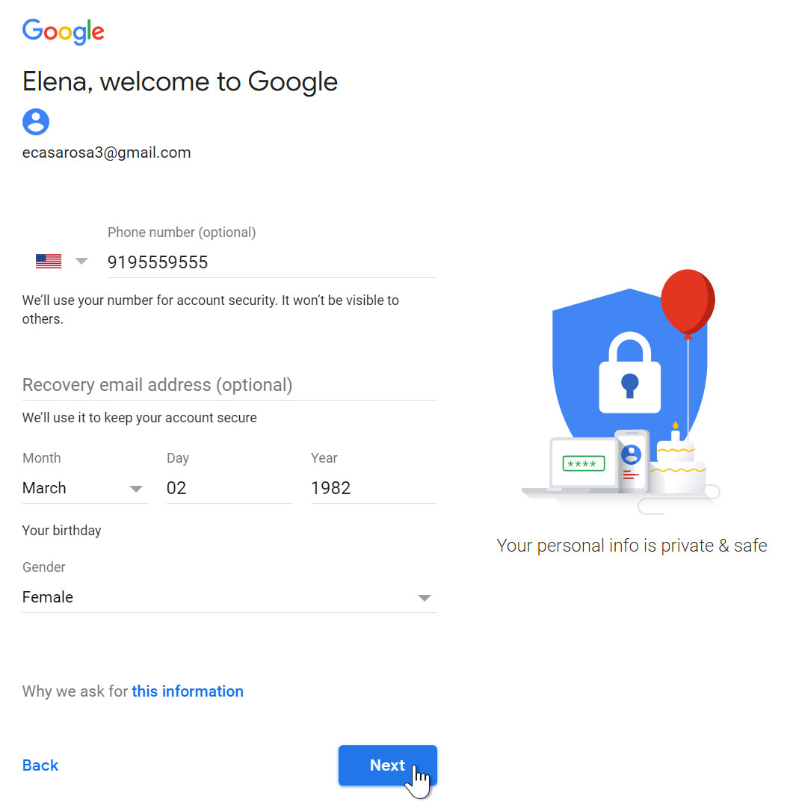
Create an Email
fill the user information
form

Slide 6
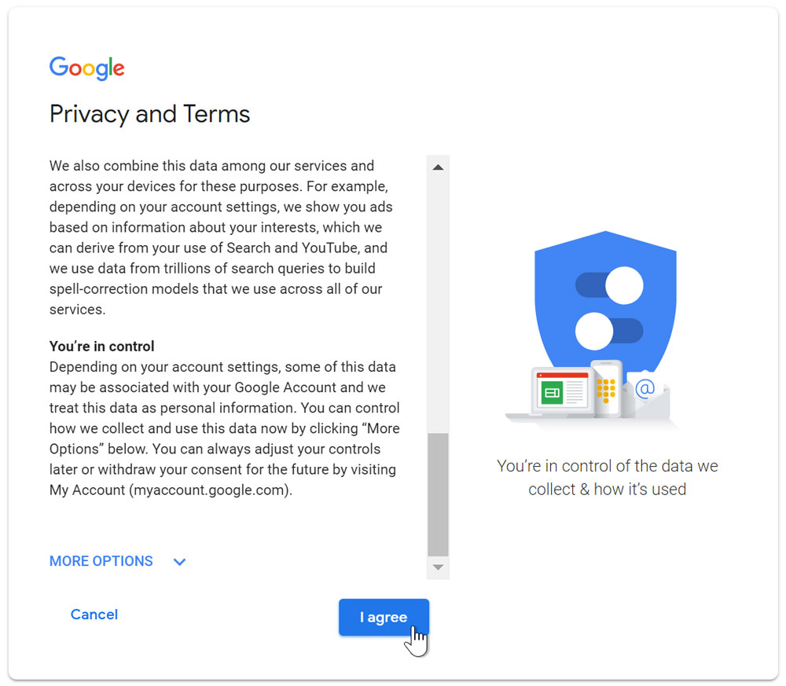
Create an Email
click agree with Google's
terms and conditions

Slide 7
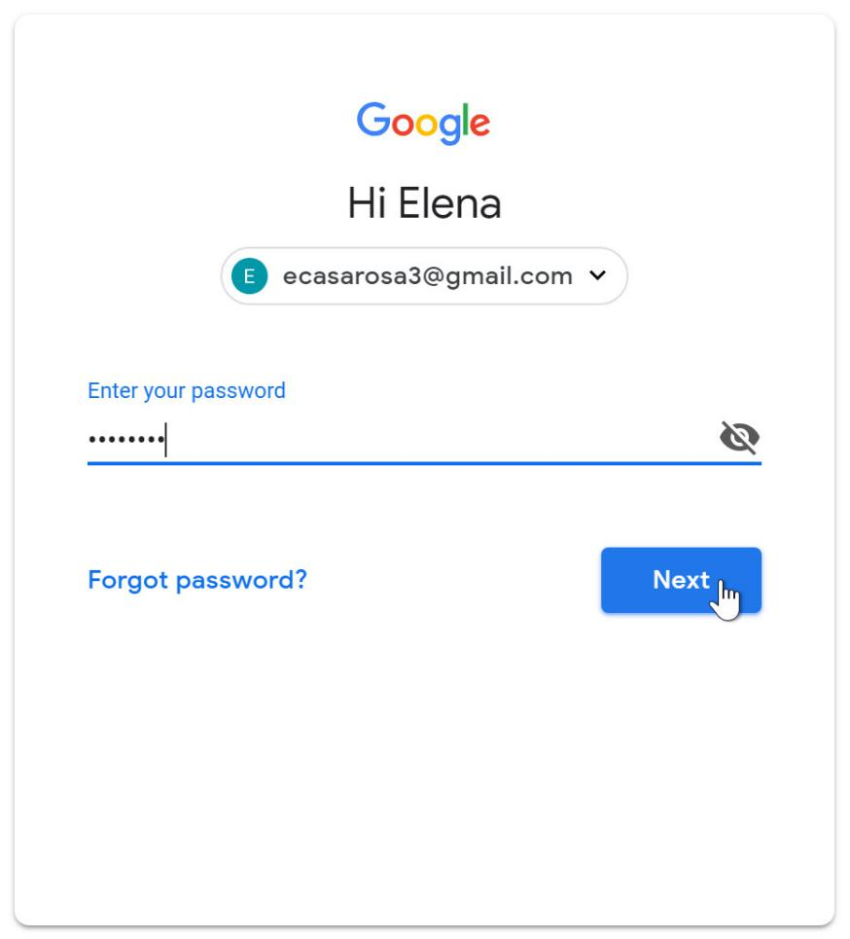
Sign in
use your email and password to sign in your account

Slide 8
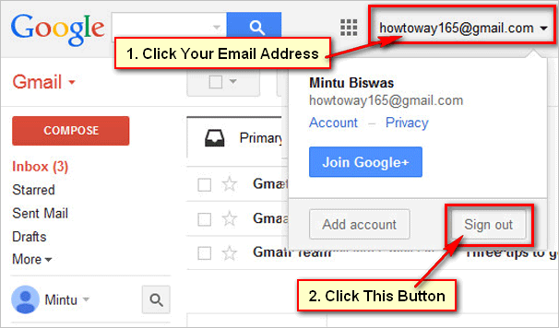
Sign Out

Slide 9


